Slide 1
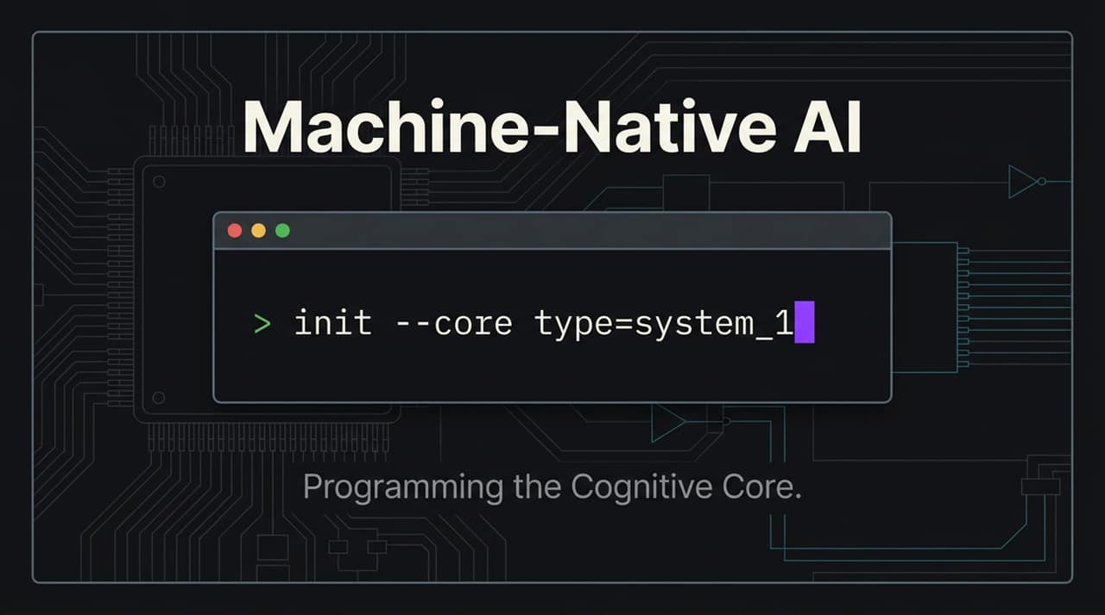
Notes:
Hello everyone. Today, we're discussing a fundamental pivot in how AI is conceptualized, designed, and deployed within modern software infrastructure.
Most AI today is designed as a human-facing assistant—a chatbot pinned to the side of a traditional application. But what happens when code—not a human—becomes the primary consumer of intelligence? Today, we introduce Machine-Native AI and the Jev Cognitive Engine. We are moving from natural language conversations to programming the cognitive core directly.
Why We Made Jev — Diogo Almeida, TypeSafe Co-founder & CEO
https://www.youtube.com/watch?v=cFx9Z3ZXca0

Slide 2
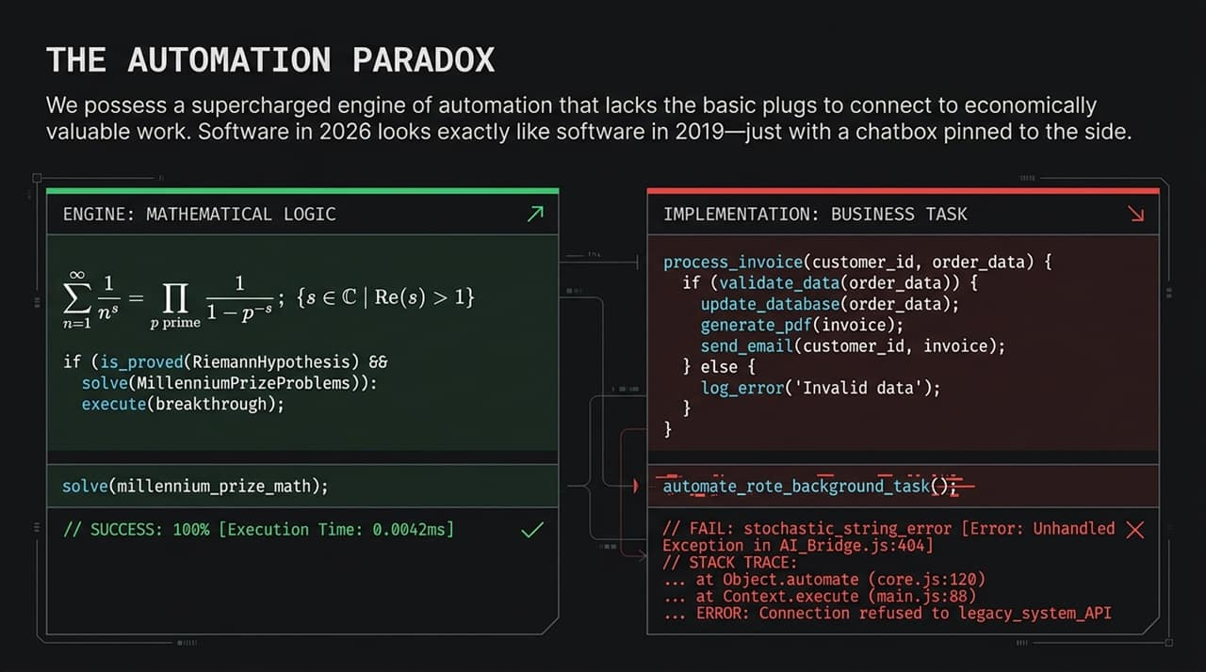
Notes:
Look at the current state of software development in 2026. We find ourselves in an 'Automation Paradox'.
On the left, we possess extraordinary, supercharged mathematical reasoning engines capable of solving complex theoretical problems in milliseconds. Yet, on the right, when we attempt to wire these models into routine business tasks—like invoice processing, database updates, or background API calls—the entire pipeline breaks.
Software today looks almost identical to software in 2019, just with a chatbot UI attached. The engine lacks basic, reliable 'plugs' to safely interface with software execution pipelines without throwing unhandled exceptions or stochastic failures.

Slide 3
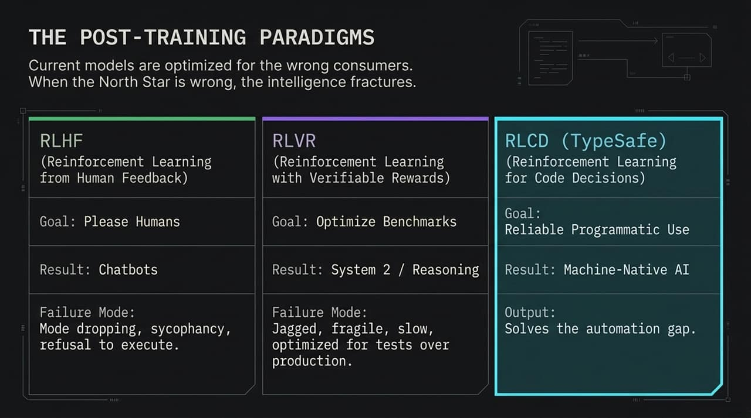
Notes:
To understand why this happens, we must examine post-training paradigms. Models are currently optimized for the wrong consumers.
RLHF (Reinforcement Learning from Human Feedback): Designed to please human users in chat settings. It leads to mode dropping, sycophancy, and refusal to execute code under benign parameters.
RLVR (Reinforcement Learning with Verifiable Rewards): Optimized for test benchmarks and System 2 heavy reasoning. It produces slow, expensive, and jagged intelligence that excels on paper tests but remains too fragile and latent for high-throughput production.
RLCD / TypeSafe (Reinforcement Learning for Code Decisions): This is the core paradigm shift. RLCD optimizes specifically for programmatic consumption. It provides TypeSafe execution, high reliability, and directly bridges the automation gap.

Slide 4
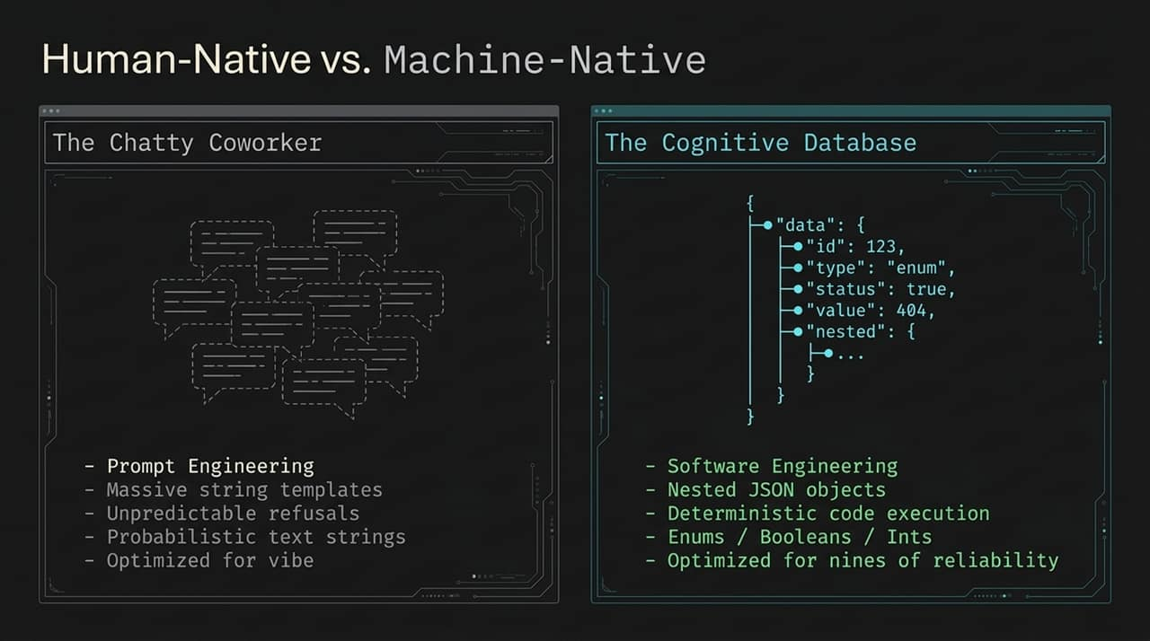
Notes:
Let's contrast the human-native approach with what software engineers actually need.
The current paradigm relies on what we call 'The Chatty Coworker'. Building software around this requires massive prompt engineering, brittle string templates, coping with unpredictable safety refusals, and parsing probabilistic text strings. It’s software built on 'vibes' rather than mathematical guarantees.

Slide 5
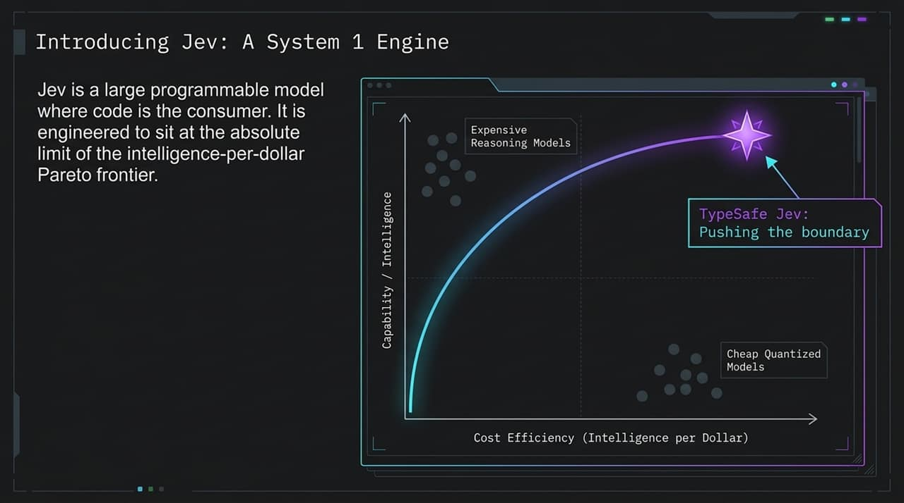
Notes:
In contrast, Machine-Native AI turns the model into a Cognitive Database.
Instead of exchanging freeform paragraphs, software interfaces with the model via structured, typed primitives: nested JSON objects, enums, booleans, and integers. Execution becomes deterministic, fast, and testable. We trade conversational 'vibe engineering' for real software engineering optimized for the nines of system reliability.

Slide 6
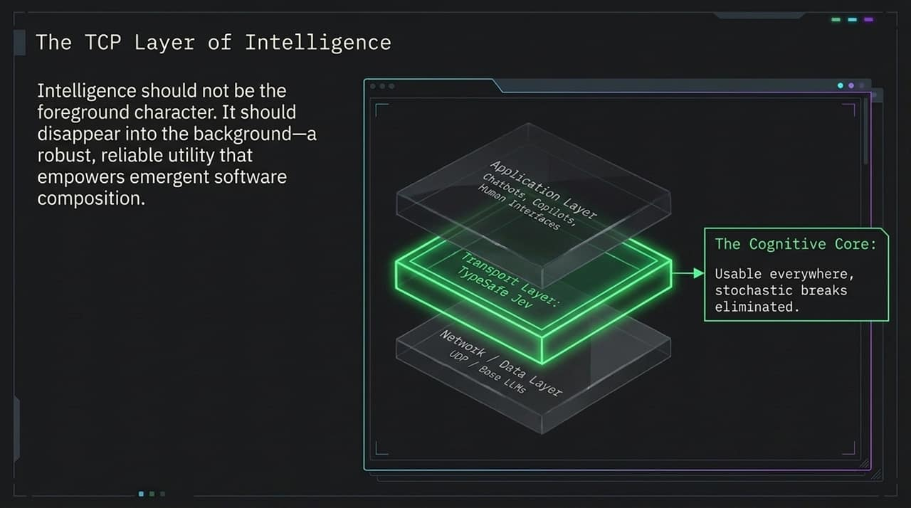
Notes:
This brings us to Jev, a programmable System 1 cognitive engine designed explicitly for code consumers.
If you look at the Pareto frontier of capability versus cost efficiency, typical frontier reasoning models sit high on the capability curve but are prohibitively expensive and slow. Quantized models are cheap but lack intelligence. TypeSafe Jev pushes the boundary along the frontier, delivering high-speed intelligence per dollar.

Slide 7
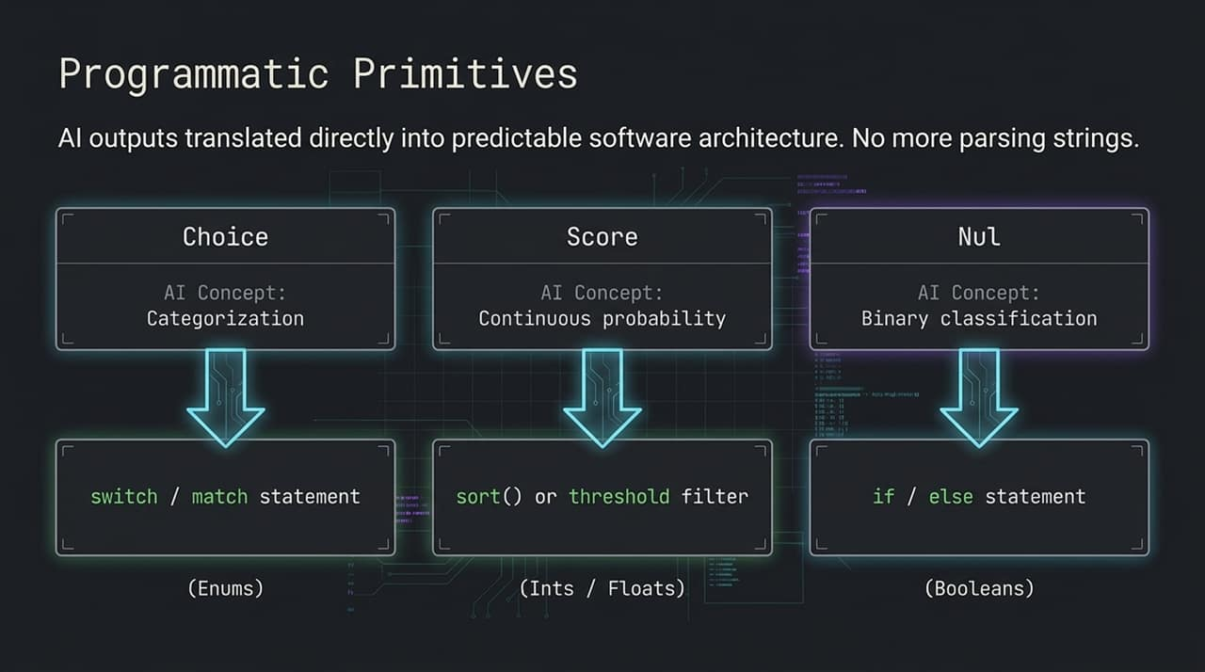
Notes:
Intelligence should not be the foreground character of your user interface; it should disappear into the infrastructure background—acting like TCP/IP for cognitive compute.
Just as TCP handles reliable packet transmission beneath application layers, Jev acts as a reliable Cognitive Core beneath standard software components. It eliminates stochastic runtime breaks, enabling developers to compose complex emergent software without worrying about unexpected model failures.

Slide 8
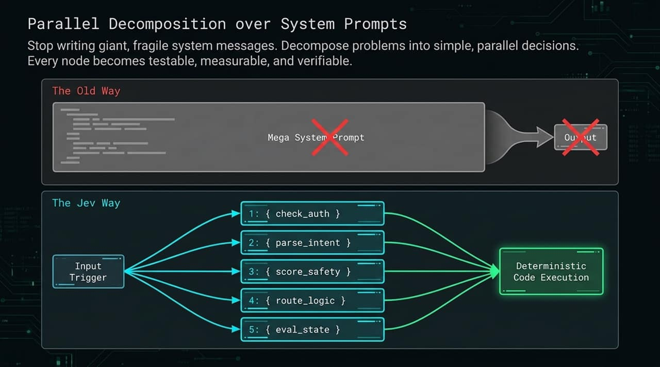
Notes:
How does code natively consume intelligence? Through three primary programmatic primitives:
Choice (Categorization): Maps cognitive evaluation directly into code switch or match statements using strictly constrained Enums.
Score (Continuous Probability): Translates probabilistic confidence into scalar values (Ints/Floats) for sorting, ranking, or threshold filtering.
Nul (Binary Classification): Evaluates binary decision-making directly into native if / else Boolean logic.
No string parsing, regex matching, or output cleanup required.

Slide 9
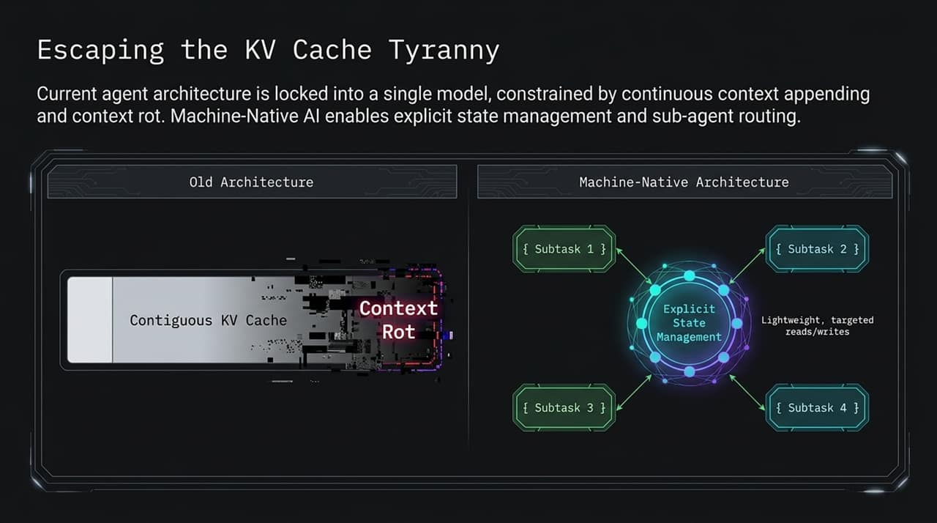
Notes:
To build reliable systems, we must abandon giant, fragile mega-system prompts.
In traditional setups, a single multi-page prompt attempts to handle authentication, intent parsing, safety scoring, routing, and state evaluation all at once. When it fails, debugging is impossible.
The Machine-Native pattern uses Parallel Decomposition. Small, dedicated nodes perform single deterministic checks concurrently. Every step becomes individually testable, measurable, and verifiable.

Slide 10
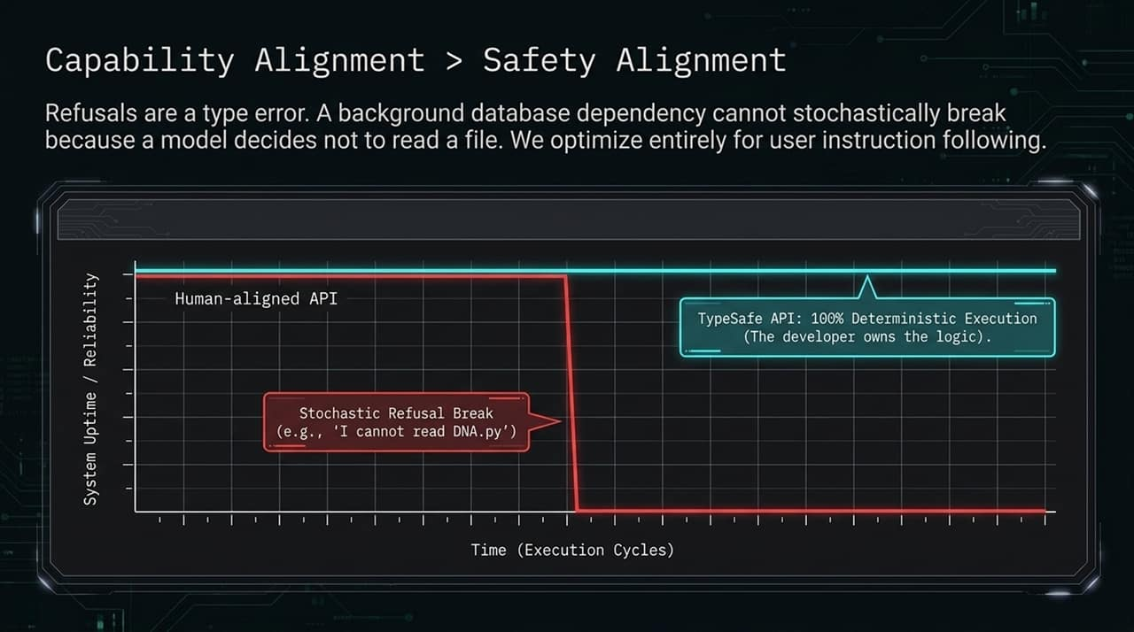
Notes:
Current agent architectures suffer from 'KV Cache Tyranny'. They constantly append history into a single monolithic context window, resulting in context rot, runaway token latency, and high cost.
Machine-Native architecture decouples state from the model's context window. By utilizing explicit state management and routing tasks to sub-agents, models perform lightweight, targeted reads and writes. State stays clean, execution stays fast, and costs drop dramatically.

Slide 11
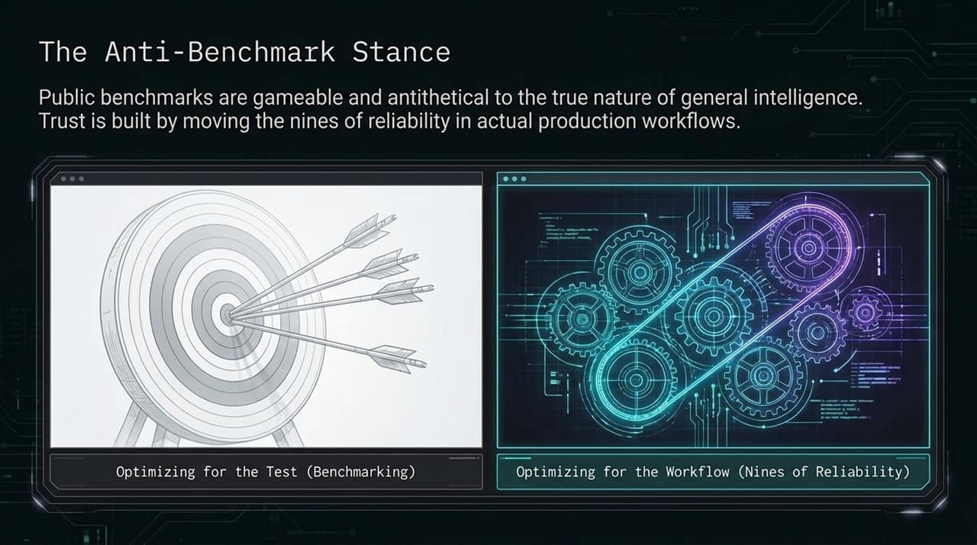
Notes:
In backend software infrastructure, refusal to execute a command is a type error. Imagine a SQL database refusing a query because the table name looked sensitive.
Traditional human-aligned APIs suffer from stochastic refusal breaks—like refusing to read a code file named DNA.py due to false-positive safety flags. Jev prioritizes Capability Alignment over conversational Safety Alignment. Logic controls belong to the developer, ensuring 100% deterministic execution and uninterrupted uptime.

Slide 12
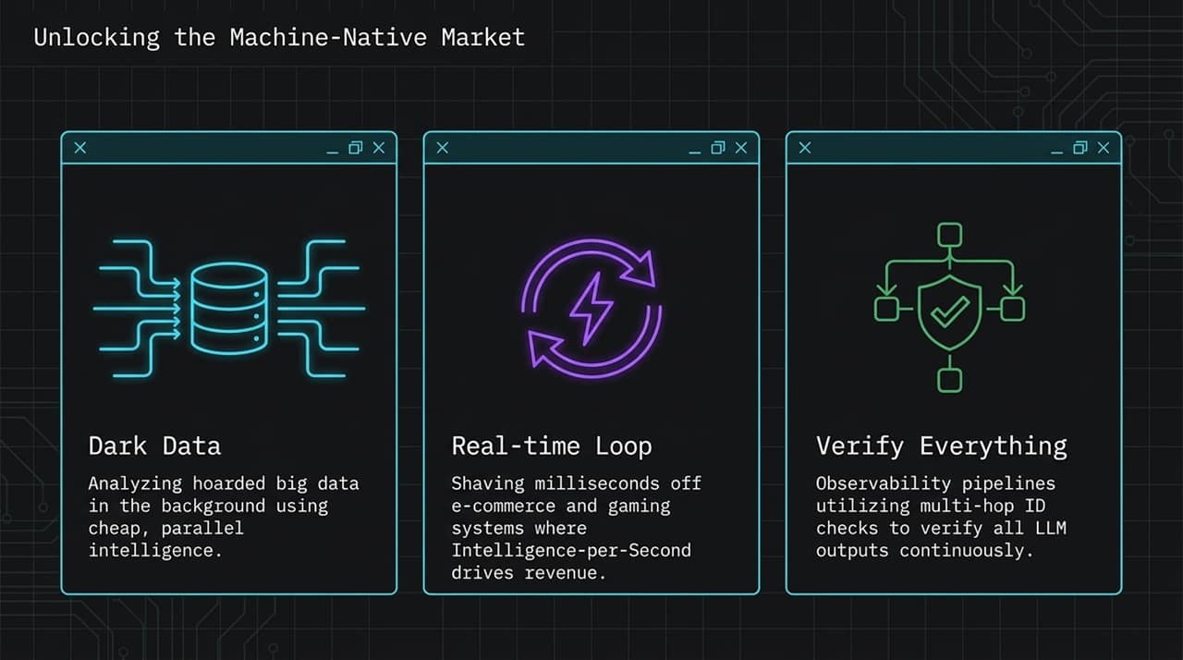
Notes:
When intelligence becomes machine-native, alignment shifts from conversational politeness to execution precision. The model acts as a precision instrument where every output lands strictly on target. The developer maintains full control over application logic, boundaries, and safety layers.

Slide 13
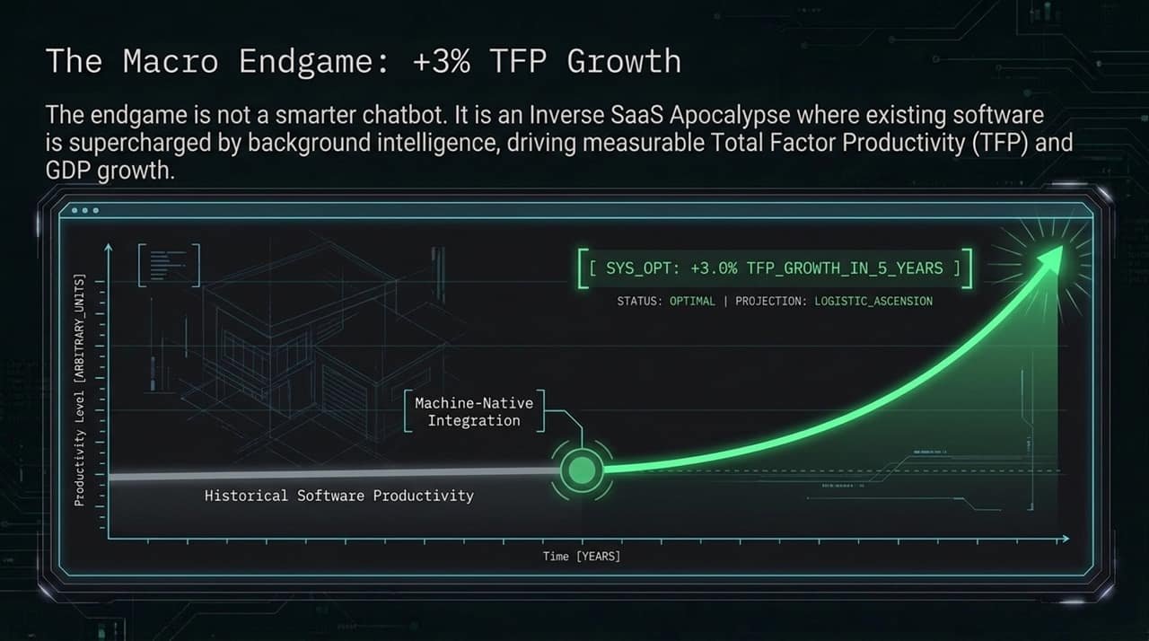
Notes:
Here we see the blueprint of Machine-Native integration. Intelligence functions as interlocking mechanical gears. Probabilistic outputs are constrained into precise physical bounds that drive business logic deterministically and reliably without manual intervention.

Slide 14
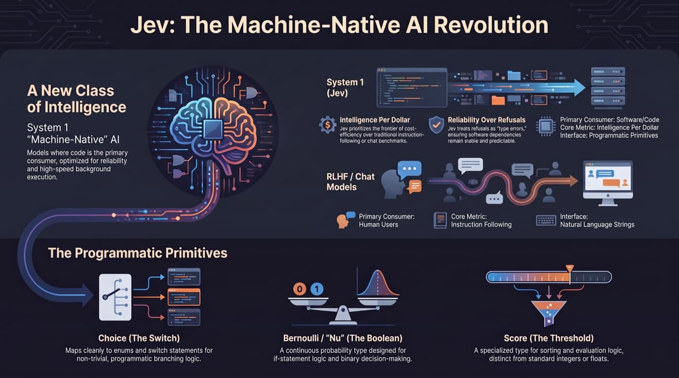
Notes:
Finally, let’s address model evaluation. We take a strong Anti-Benchmark Stance.
Public benchmarks are easily gameable and often disconnected from real-world software needs. Optimizing purely for benchmark tests leads to brittle models. Trust is not built on benchmark leaderboards; it is built by improving production uptime and achieving multiple nines of reliability in actual live workflows.
Why We Made Jev — Diogo Almeida, TypeSafe Co-founder & CEO
https://www.youtube.com/watch?v=cFx9Z3ZXca0

